Slide 1
Wages
Form 1040 – Line 7
Pub 4012 – Tab D
Pub 4491 – Lesson 9
Notes:
#16 – added open issue
#38 – open TS issue
#51 – open TS issue
#56 – open TS issue
#60 – open TS issue
#62 – added TS does not have W-4

Slide 2
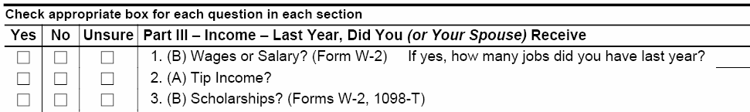
Wages – The Interview
Notes:
Encourage counselors to ask probing questions
It is not “prying,” it is essential to an accurate return

Slide 3
The Interview – A Conversation
Prior year’s return
Forms W-2 or other records
  Household employee (no W-2)
Forms 1098-T (scholarship exceeds expenses)
At interview, identify possible scholarship income; do not finalize until all return info has been entered
Notes:
Emphasize:
Steps and questions to determine whether in scope, before touching the computer
Prior year’s return
Review all income areas to understand the taxpayer’s tax situation
Most taxpayers’ situation does not vary much year to year
Was there household worker income reported last year?
W-2 forms
Look for out-of-scope items (detailed later)
Is it the right SSN or does TP have an ITIN?
Does the form look legit?
Is it the right year?
Household employees – discussed later
1098-T form
Does scholarship amount exceed expenses?
Is any of it for the prior year and education credit was claimed in prior year?
May need to recapture some of the credit – out of scope
If unsure, reassure participants that LC or QR person can help!

Slide 4
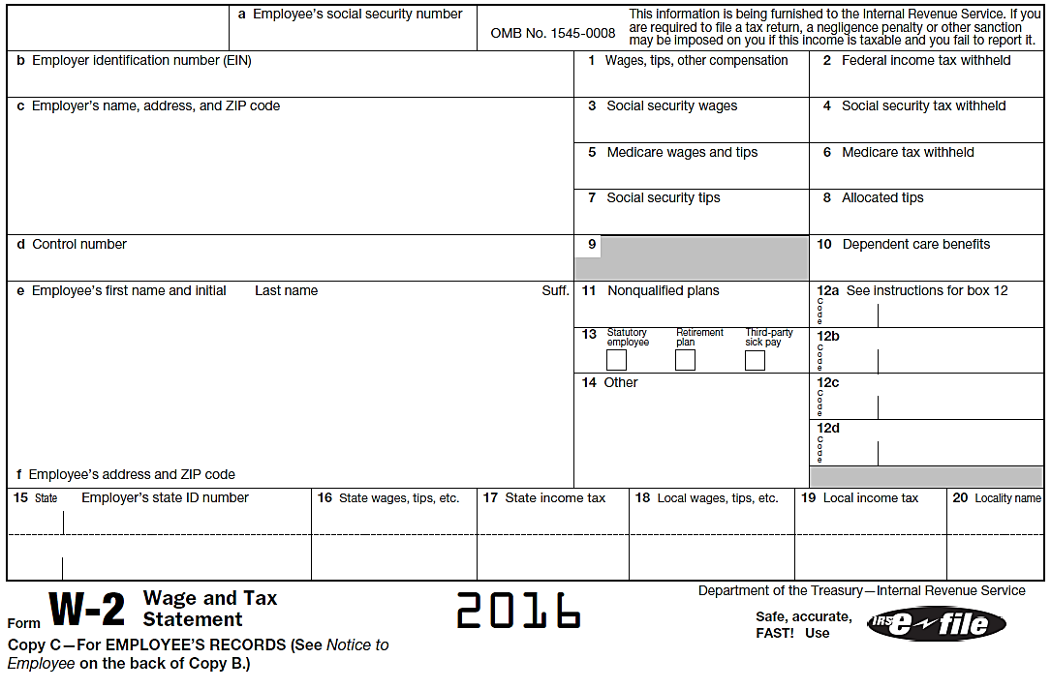
Entering W-2
The Tax Form
Verify current tax year
Notes:
Emphasize
Every labeled box must be input
Taxpayers sometimes bring in prior year W-2s by mistake so be careful

Slide 5
Interview: Missing W-2
Taxpayer “should” receive W-2 by early February
If not, taxpayer should pursue with employer
  If employer can’t help, taxpayer should contact IRS on 800-829-1040, but not before 02/15/2015
If IRS can’t help, can complete return
  Use substitute Form 4852 (discussed later)
  Must have pay stub with full-year cumulative information
Notes:
Haven’t received a W-2?
First contact employer to find out if or when it was mailed or can they pick it up
If still haven’t received a reissued W-2 in a reasonable amount of time – taxpayer should contact the IRS for assistance
If they still haven’t received a W-2 – need to file the return with Form 4852
Keep a copy of Form 4852 for their records.
If employer has ceased operations – taxpayer should also file a copy with Social Security Administration
If the taxpayer has an ITIN – do not enter the SS# on the 4852 – the return is filed with the ITIN only
Household employees – discussed later

Slide 6
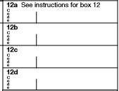
What’s Out of Scope on W-2?
With W-2 in hand determine if out of scope:
Box 12
  Code R – Archer Medical Savings Acct (MSA)
  Code T – adoption benefits
  Code Q – nontaxable combat
  pay (unless certified for Military)
  Code W – employer contribution
  to Health Savings Acct (unless
  certified for HSA)
Notes:
If possible, show participants how to look up the instructions in Pub 4012, TaxSlayer, or IRS.gov form W-2 to see all the box 12 codes

Slide 7
What’s Out of Scope on W-2? (cont.)
Ministers/church workers (special tax rules)
Very high income that is subject to the additional Medicare tax
  MFJ: $250,000
  MFS: $125,000
  S, HoH or QW: $200,000
Notes:
Ministers or certain church works
This may be noted in box 14
The additional Medicare tax (Form 8959) is out of scope
Married filing jointly..........$250,000
Married filing separately........$125,000
Single, Head of household, or Qualifying widow(er) $200,000

Slide 8
Entering W-2 Income
Options to enter wage income in TaxSlayer
  Quick File / Taxpayer Profile
  Form search box
  Link from Summary/Print 1040 view line 7
Notes:
8
Quick File / Taxpayer Profile take you to the input form directly.

Slide 9
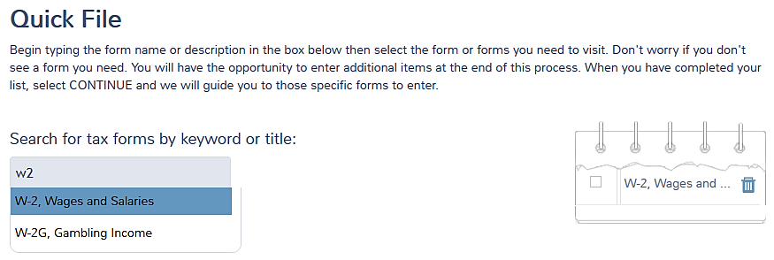
Getting to W2 Input Screen in Quick File
Enter W2 in search box
Click on W-2 Wages and Salaries
TaxSlayer adds to form list
1
3
2

Slide 10
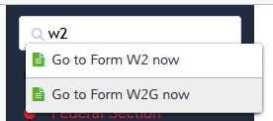
Getting to W2 Input Screen in Main Menu Form Search Box
Type W2 in search
Click W2
Notes:
10

Slide 11
Getting to W2 Input Screen
Line 7 Link Method
From Summary/Print screen
Select line 7 amount box

Slide 12
Entering W-2
(Almost) all information that is on W-2 form should be entered on TaxSlayer input form

Slide 13
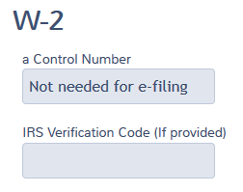
Entering W-2
Control number not needed
Enter IRS verification number, if any

Slide 14
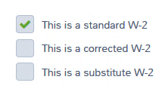
Entering W-2
Standard W-2 is default
Click if corrected
Substitute generates F 4852

Slide 15
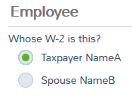
Entering W-2
If MFJ, check whose W-2
If employee address is different on W-2, enter address as on W-2

Slide 16
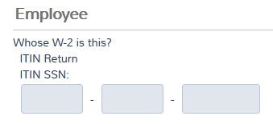
ITIN* Returns
The Input Form
Spouse with ITIN and W-2 with wrong SSN not in TS. Issue #516.
ITIN return? (TaxSlayer knows)
W-2 may have erroneous SS number
Enter SSN on W-2
* IRS assigned ID number, not a social security number
Notes:
Emphasize
ITIN returns can be e-filed
Not be eligible for all benefits (e.g. EIC)

Slide 17
Entering W-2
If employer ID is in database, employer data will auto-fill
If employer name or address is different on W-2, enter as on W-2

Slide 18
Entering W-2
Input entire form W-2
Compare social security and Medicare wage and tax amounts
  Input actual amounts from W-2
Same for state information
  Manual adjustment likely needed on state return if state wages differ
Notes:
Emphasize
Be sure to input everything that’s on the W-2 first
Government/civil service employees may not be in social security system
Some box 12 items are subject to social security and Medicare tax, even though not currently taxable
Such as 401(k) deferrals
Caution for state differences: may need to make manual adjustment on state form
TaxSlayer may not carry a fed-state difference to the state form

Slide 19
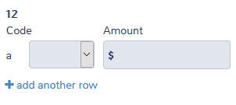
W-2 Box 12 or 14 Codes
Tab to input field and type code letter
Or
Use drop-down list
Notes:
Some box 12 items are subject to social security and Medicare tax, even though not currently taxable
Such as 401(k) deferrals

Slide 20
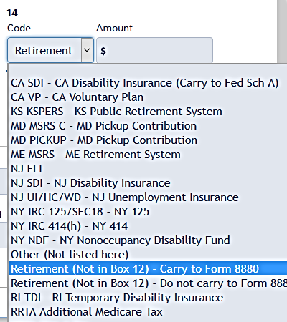
W-2 Box 14
Some employers put retirement plan in box 14
Use proper choice in drop-down list

Slide 21
W-2 Box 12 codes
Often seen codes (26 possible codes):
  D – Elective deferrals to a section 401(k) (Codes E through H are elective deferrals to other qualified plans)
  DD – Cost of employer-sponsored health coverage
Careful: don’t confuse D and DD
Notes:
Informational
Code D will add Form 8880 to the return (may need to make additional entries to it)
Code DD is informational only and does not affect the income tax return
All codes as shown on W-2 should be input into TaxSlayer (or “other” in box 14 data, if needed)
Emphasize
Box 12 out of scope codes
Code R – Archer MSA
Code T – adoption benefits
Code Q – nontaxable combat pay, unless certified for Military
Code W – employer contribution to HSA, unless certified for HSA
If box 14 has “401k”
Leave in box 14 and select from drop-down list that it qualifies or not for Form 8880 retirement savers credit (previous slide)

Slide 22
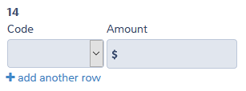
Adding W-2 Boxes 12 and 14
Add additional box 12 rows, if needed
Add additional box 14 rows, if needed

Slide 23

W-2 – Box 13
Statutory employee – special status
  FICA taxes are taken out by the employer
  Taxpayer can report income and deduct expenses using Sch C
TaxSlayer moves income from Line 7 to Sch C when box is checked (see business income lesson)
Notes:
After clicking continue, TaxSlayer asks if want to go to sch C now (see Business Income lesson)
Or can continue with the return

Slide 24
W-2 – Box 13
Retirement plan – participant
  See IRA deduction in adjustments lesson
3rd Party sick pay
  Reports outside insurer payments

Slide 25
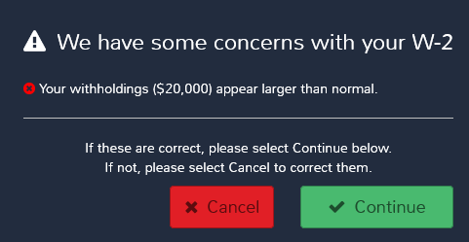
W-2 Warnings
TaxSlayer warns if unusual W-2 items
Review and correct as needed
Continue
Notes:
Emphasize
Inquire of the taxpayer if withholding amount seems extraordinarily high
Compare to prior years
Could be valid, if
there is non-withholding income (interest or dividends) and
taxpayer does not want to make estimated payments

Slide 26
Substitute W-2
Complete W-2 input
  Use prior year W-2 employer data, if applicable
  Use last pay check stub
  Taxpayer needs to provide year-end totals if not on pay stub
  If IRS sent taxpayer a Form 4852 with information on it, transfer it to TaxSlayer

Slide 27
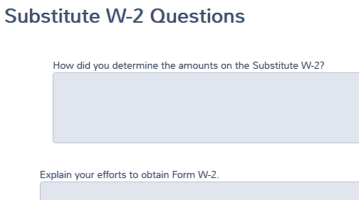
Substitute W-2
Clicking Continue with substitute W-2 in TaxSlayer leads to F 4852 questions
Answer the questions
TaxSlayer automatically generates Form 4852
Notes:
Do not use 4852 if taxpayer was not treated as an employee

Slide 28
Substitute W-2 – Form 4852
Taxpayer should retain copy of 4852
If taxpayer gets W-2 later with different information, may need to amend return
Taxpayer may need to follow up with Social Security Administration to get credit for FICA taxes paid
Notes:
From Instructions to Form 4852:
Retain a copy of Form 4852 for your records
Check your Social Security Statement (received at least a full year after the date shown on line 4) against Form 4852
If the earnings you reported on Form 4852 are not shown in the statement, you should contact the Social Security Administration (SSA) at the telephone number shown on the statement
Alternatively, after September 30 following the date shown on line 4, you may contact your local SSA office to verify wages reported by your employers

Slide 29
Entering -0- Wage W-2
Special Situation
W-2 with -0- wages (box 1)
  May be reporting sick or disability pay
  Need to enter only if tax withheld
  Cannot enter zero-wage W-2
  Cannot enter withholding > wages
Notes:
Emphasize
Very rare situation
Always check with LC/ QR for guidance if unsure

Slide 30
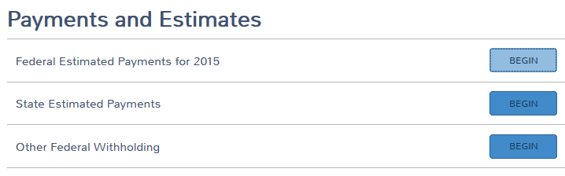
Entering -0- Wage W-2
Special Situation cont.
Go to Payments and Estimates > Other Federal Withholding
Enter withheld tax per W-2
Notes:
Emphasize
Very rare situation
Always check with LC/ QR for guidance if unsure

Slide 31

Need to add another W-2?
Simply add another one
Notes:
Can also click the “add” button and type in form name

Slide 32
Entering W-2
Completely enter all information on each W-2, before going to next one
Double check employer ID numbers, names and addresses!

Slide 33
W-2 Tips
All income must be reported and is taxable for income tax
Not all income is subject to Social Security and Medicare taxes (FICA) (see $20 rule later)
Notes:
Workers that receive tips are supposed to report their tips to their employer
Exception for tips that are no more than $20 per month

Slide 34
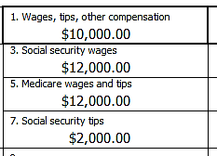
W-2 Social Security
Tips
Social Security Tips (Box 7) is income in addition to wages in box 1
W-2 boxes 3 and 5 include these tips
Only additional entry would be if there are unreported tips
Notes:
IF taxpayer is employed in a position that normally receives tips, inquiry should be made

Slide 35
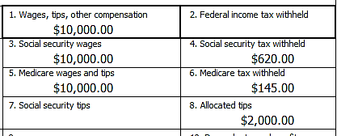
W-2 Allocated Tips
An assumed amount of tips received by worker
  Set at 8% of underlying charge
  such as restaurant bills
Allocated Tips (Box 8) is income in addition to wages in box 1
  For income tax and FICA taxes
Notes:
Allocated tips are a fictitious amount – the law says at least 8% unless employee keeps a good log

Slide 36
W-2 Allocated Tips
TaxSlayer automatically
  Adds allocated tips to wages line 7
  Takes allocated tips to Form 4137 (which computes FICA tax on the amount)
Notes:
Allocated tips are a fictitious amount – the law says at least 8% unless employee keeps a good log

Slide 37
W-2 Allocated Tips
Minimum amount of imputed tip income that must be declared, absent records
Worker that keeps good records (tip log) can declare
  More tip income
  Less tip income
Notes:
IRS prints free tip logs that Taxpayers can order from IRS.gov or by phone

Slide 38
W-2 Allocated Tips
TaxSlayer adds Form 4137 when W-2 Box 8 Allocated Tips is used, otherwise add form if needed
If taxpayer keeps good records, can use actual amount of tips on Form 4137, Line 4
  Compute the difference and enter on F 4137
  Confirm total wages is correct on 1040 Line 7
Note: If using allocated tips amount, amount not reported because <$20 per month is deemed included in allocated amount
TaxSlayer Open Issue #479
Notes:
TaxSlayer does not allow a negative adjustment at this time in form 4137.

Slide 39
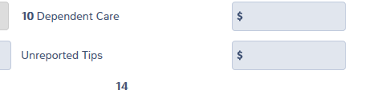
W-2 Unreported
Tip Income
Input all unreported tips on respective employer W-2 input screen
TaxSlayer adds to wages line 7 and carries amount to Form 4137 for FICA tax

Slide 40
W-2 Tips $20 Rule
Tips < $20 per month are not subject to FICA
  Enter amount on Form 4137 input form
  TaxSlayer reduces income for FICA tax only and completes Form 4137

Slide 41
Other Line 7 Wage
Income / Adjustment
Income not on a W-2
  Taxable scholarship or grant
  Household employee income
W-2 income that may need adjusting for other purposes
  Penal income (considered unearned)
Notes:
Don’t see penal income very often – may surface during the interview

Slide 42
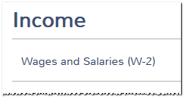
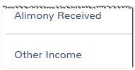
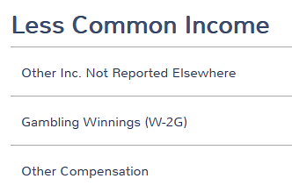
Other Line 7 Wage Income/Adjustment
Income screen, click Other income
Or
Summary view, click line 21
Takes you to Less Common Income
Click Other Compensation…
Notes:
Emphasize
Don’t input scholarship income until the education benefits are done after all other info is input
Taxable scholarships are covered in slide deck 28
Also see Education Benefits slides and Education Cookbook on OSHC for tax-optimizing strategies

Slide 43
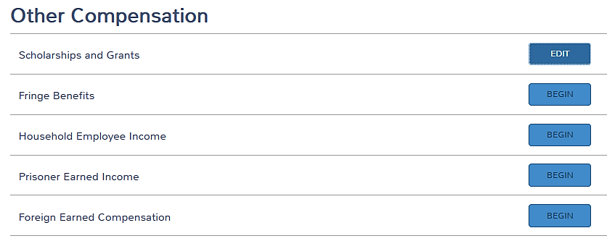
Other Line 7 Wage Income
… takes you to Other Compensation
Out of scope
International Certification

Slide 44
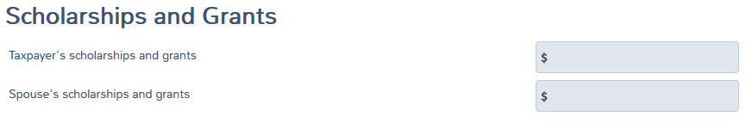
Taxable Scholarship or Grant
Not on W-2
Scholarships and Grants
If student is a dependent, income goes on the student’s return!
Notes:
The amount of taxable scholarships is done at after all other items have been entered.

Slide 45
Taxable Scholarship or
Grant Not on W-2
Earned income for
  Filing requirement
  Standard deduction calculation
Unearned income for all other purposes
  Kiddie tax, EIC, child tax credit, dependent care credit, etc.

Slide 46
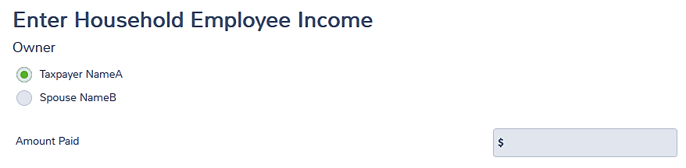
Household Employee
Income Not on W-2
Amount is less than $2,000 per employer
No withholding or FICA taxes apply
Can have multiple employers so long as each is less than $2,000 (enter total amount)
Notes:
Informational:
Payers who pay more than $2,000 in the year or cash wages of $1,000 in a quarter must file Schedule H and pay the employment taxes for their household employee
Sch H is out of scope
Payees must report all their income, even if below the employer reporting limit
Informational note W-2:
No withholding or FICA taxes apply to employee who is related to the employer as:
Spouse, child under age 21, (some) parents, or anyone under age 18
Cannot be the employee’s principal occupation (not a test for students)
See Pub 926
Some household workers are self-employed, use Schedule C instead
Household workers can include
Housekeepers
Nannies
Babysitters
Among others

Slide 47
Household Employee
Income Not on W-2
If household employee income not on W-2 is more than $2,000 per employer, TP may wish to show as a business
  See business income lesson

Slide 48
Household Employee
Income Not on W-2
Household workers can include
  Housekeepers
  Nannies
  Babysitters
  Caregivers
  Among others

Slide 49
Prisoner Earned Income
Income earned while
  An inmate in a penal institution
  In a work release program
  While in a halfway house
Not treated as earned income for child and dependent care, earned income, or additional child tax credits

Slide 50

Prisoner Earned Income
Input total prisoner earned income that was included in W-2 as a positive amount
TaxSlayer reduces earned income

Slide 51
Prisoner Earned Income
TaxSlayer reduces the earned income shown elsewhere in the return for:
  Child and dependent care credit
  Earned income credit
  Additional child tax credit
Does not reduce taxable income!
Open issue #485 – earned income for CDC is not reduced. - lsa
Notes:
May not see prisoner income very often
Pending production changes, may need to use this feature for Medicaid waivers reported on W-2 (see later slides and Other Income lesson)

Slide 52
Prisoner Earned Income
Example
Joe has W-2 income of $23,000, of which $5,500 was during work release
  Enter W-2 as normal
  Enter $5,500 as prisoner earned income
  Earned income is reduced to $17,500 for the credits
  Taxable wages remain $23,000

Slide 53
Other Line 7 Income
If taxpayer is under the minimum retirement age for employer plan, a disability “pension” is taxed as wages on line 7
  See retirement income lesson
  Eligible for EIC!
Notes:
Emphasize
The interview should have already identified that the 1099-R has code 3
Can look at the prior year’s return for confirmation
Must still ask the question
Once Taxpayer reaches the minimum retirement age, distribution will remain as retirement income
Some employers report using W-2 instead of 1099-R and that is ok

Slide 54
Medicare Waiver Payments Reported on W-2
Taxpayer presents W-2 that qualifies as Medicaid waiver payments
  It must be excluded
First, enter information from W-2 as normal
Notes:
To be excludible, care provider and care recipient must live together in the same home
TaxSlayer has said production version will have a Medicaid waiver box on the W-2 input to remove it from wages and earned income – to be confirmed

Slide 55
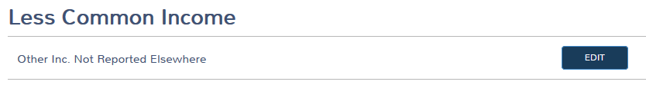
Medicare Waiver Payments Reported on W-2
Click Line 21 in Summary/Print
  Takes you to Less Common Income
Click Other Inc. Not Elsewhere
Notes:
This is until TaxSlayer production changes

Slide 56
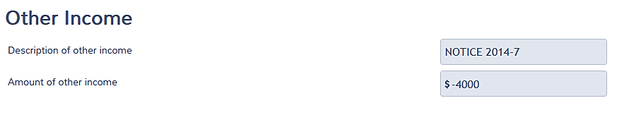
Medicare Waiver Payments Reported on W-2
Enter in Other Income as NEGATIVE
Use prisoner income to reduce earned income until TaxSlayer production
Open issue #485 – earned income for CDC is not reduced. - lsa
Notes:
This is a temporary workaround – TaxSlayer production should have a better answer

Slide 57
Quality Review –
Wages Line 7
Verify all W-2 data has been input correctly
  Employer Identification Number (EIN)
  Employer name
  Employer address
  Social Security/Medicare amounts
  All box 12 items
  Stat employee/retirement/3rd party sick

Slide 58
Quality Review – Wages Line 7
Confirm Line 7 has all that it should have
  How many jobs or W-2s?
    Per Intake/Interview/QR form
    In return
  Compare to prior year

Slide 59
Quality Review – Wages Line 7
After all other aspects of return are done, confirm Line 7 is complete
  Tips from Form 4137
  Household worker income
  Disability pension
  Taxable scholarships
Notes:
This part of QR is done at the end, after all items have been input

Slide 60
Quality Review – Wages Line 7
Confirm any amounts on line 7 that are not earned income
  Prisoner income
  Excluded Medicaid waiver payments
Open issue #485 – earned income for CDC is not reduced. - lsa

Slide 61
Quality Review – Wages Line 7
Wage income may trigger other aspects in return
  Proceed methodically through each
  e.g. IRA contributions or deductions, retirement saving credit, EIC
All will be covered in separate lessons
Notes:
Emphasize
Saving for retirement is mentioned here to get thought going as the return is being prepared
It is the taxpayer’s responsibility to manage their tax affairs
We can remind them of opportunities to reduce their taxes if they are eligible

Slide 62

Taxpayer Summary
Wages Line 7
When return is done, revisit
Is withholding too high? Too low?
  Can change using W-4
  May need state “W-4” form, too
  (W-4 not available in TaxSlayer)
Notes:
Emphasize
The real exit interview is done at the end of the return preparation process
These exit interview comments are to highlight topics specific to Wages

Slide 63



Income - Wages
Comments
Questions

